Slide 1
EMV Solutions
SLIM CD, INC

Slide 2
EMV Liability Shift - What changed?
Counterfeit Cards - Stolen card data burned onto mag stripe of a different card
After Oct 2015
Until Oct 2015
Cardholder’s Issuing Bank
Cardholder’s Issuing Bank
EMV Chip Transactions
Swiped transactions (in person)
Merchant
Merchant
Swiped transactions (in person)
Keyed transactions at register
All Card Not Present transactions
(phone, ecommerce, mobile)
Keyed transactions at register
All Card Not Present transactions
(phone, ecommerce, mobile)

Slide 3
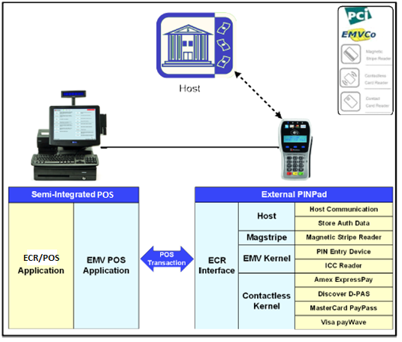
EMV - Fully Integrated
Touches EMV data
Touches Cardholder Data
Full feature-functionality controlled by ECR/POS
In scope for EMV
In scope for PCI (may be reduced by P2PE)

Slide 4
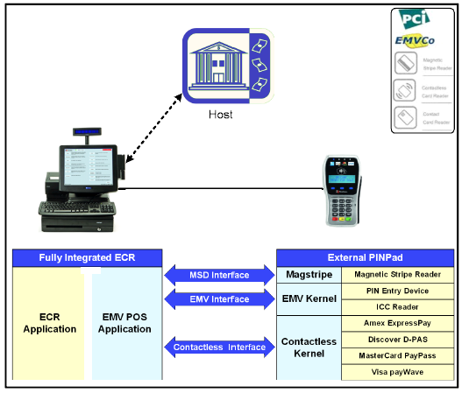
EMV – Partially Integrated
POS software touches EMV data
POS software touches Cardholder Data
Feature-functionality controlled by POS software
Out of scope for EMV
May be in our out of scope for PCI

Slide 5
EMV – Semi Integrated
Only PINPAD touches EMV data
Only PINPAD touches Cardholder Data
Functionality controlled by PINPAD
Out of scope for EMV
ECR out of scope for PCI

Slide 6
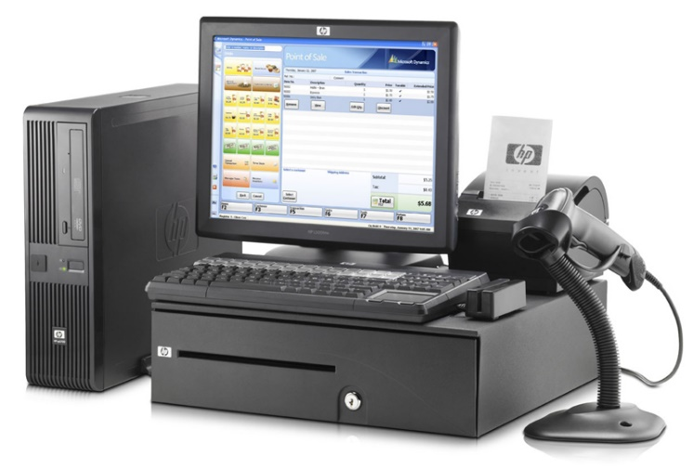
EMV in the cloud
POS SYSTEM
SLIM CD
PINPAD with VPN IP

Slide 7
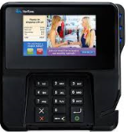
Option 1 - Direct Web Service Payment Calls
POS or Kiosk Stack
1. POS Interface Code
POS Interface Code written by the POS developer.
Developer contacts device directly, with full control over all prompts and transaction flow.
Developer uses SLIM CD Web Services or libraries to process through Vantiv (or others)
Hardware manufacturer provides Windows device drivers (if needed)
2. Developer integrates to device
SlimCD.com
Payment
Web Services
4. Device Driver from Device Company
3. SlimCD Web Services or libraries
The developer touches the cardholder data
EMV and PCI certification by the developer IS REQUIRED

Slide 8
Option 2 -.NET Libraries on a POS or Kiosk
POS or Kiosk Stack
1. POS Interface Code
POS Interface Code written by the POS developer.
SlimCD Hardware Abstraction Layer is a set of calls that allow the developer to call the same methods for:
Connecting
Starting a transaction by sending an amount (etc.)
Getting back the approved/declined results
SlimCD Per Device Code communicates with the device and to SLIMCD.COM
Hardware manufacturer provides Windows device drivers (if needed)
2. SlimCD Hardware Abstraction Layer
SlimCD.com
Payment
Web Services
3. SlimCD Per-Device Code
4. Device Driver from Device Company
The developer never touches the cardholder data
No EMV certification required by the developer

Slide 9
Option 3 -VPN on a POS, with Web Services
POS, WEB or Kiosk Stack
SlimCD.com
Hardware Web Services
POS Interface Code written by the POS developer.
Developer calls web service on SLIM CD’s side that handles all communication with the driver.
Web Services return approved/declined as XML.
1. POS Interface Code
2. SlimCD Hardware Abstraction Layer
SlimCD.com
Payment
Web Services
3. SlimCD Per-Device Code
4. Device Driver from Device Company
The developer never touches the cardholder data
No EMV or PCI certification required by the developer
SAQ-B can be used by merchant because device is part of our VPN network

Slide 10
Option 4 –Launch Our App
POS Stack
1. POS Interface Code
POS Interface Code written by the POS developer.
Launch the SLIM CD app, providing amount and transtype in an XML file
SlimCD for PC operates the hardware and writes back a response
2. SlimCD for PC
2a. SlimCD Hardware Abstraction Layer
SlimCD.com
Payment
Web Services
2b. SlimCD Per-Device Code
4. Device Driver from Device Company
The developer never touches the cardholder data
No EMV or PCI certification required by the developer

Slide 11
Leveraging Existing Products
PC
Mobile
Web

Slide 12
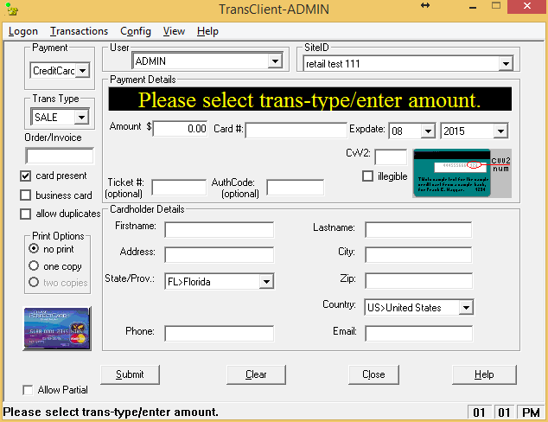
TransClient – Slim CD Desktop Software
Runs transactions
Supports SEARCH
Supports clerks/users
Prints Receipts
Captures Signatures
Sends email receipts
Credit, Debit, Check, Gift
Retail, Restaurant, Hotel, etc
CAN BE LAUNCHED by other apps

Slide 13
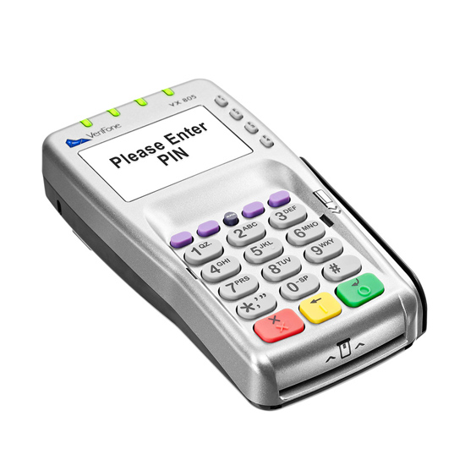
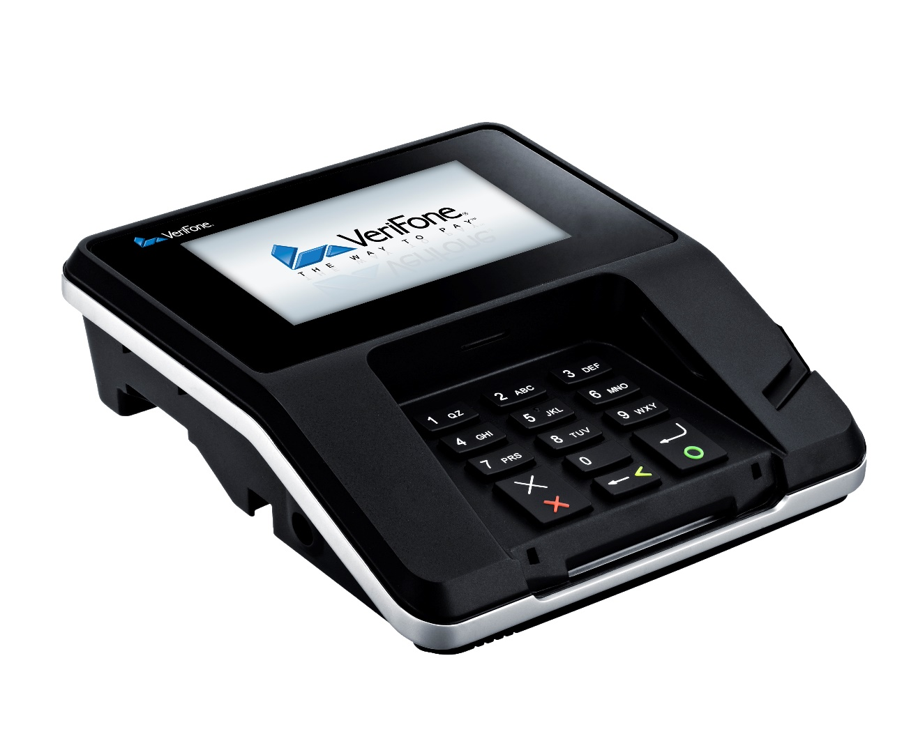
TransClient Supports New Pinpads TODAY!
VX 805
MX 915

Slide 14
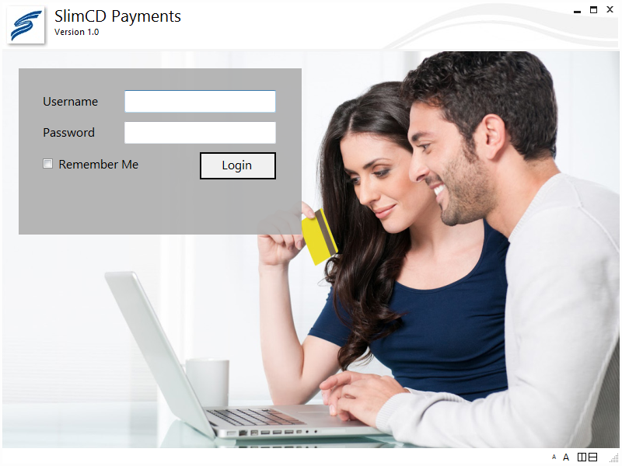
SlimCD for PC – The new desktop app
Works like TransClient.exe
MSR readers
Keyed transactions
Plus - EMV PINPads!!
SLIM CD web-managed client/clerk logins (like the website and mobile devices)
XML Login and REQ file support

Slide 15
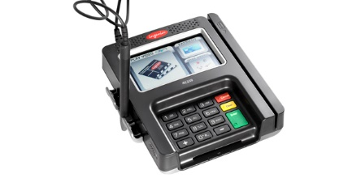
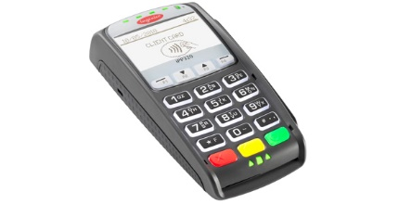
EMVDLL - Pinpads
VERIFONE
VX 805
MX 915
INGENICO
IPP320
ISC250

Slide 16
Launched App Demo
Uses XMLLogin.XML
Uses standard XML.REQ and XML.ANS files
Supports additional data for Hotels in the XML
Support for Hotel Prompts is coming in V2
Support for checks and gift cards is coming in V2
Product in extended BETA now.

Slide 17
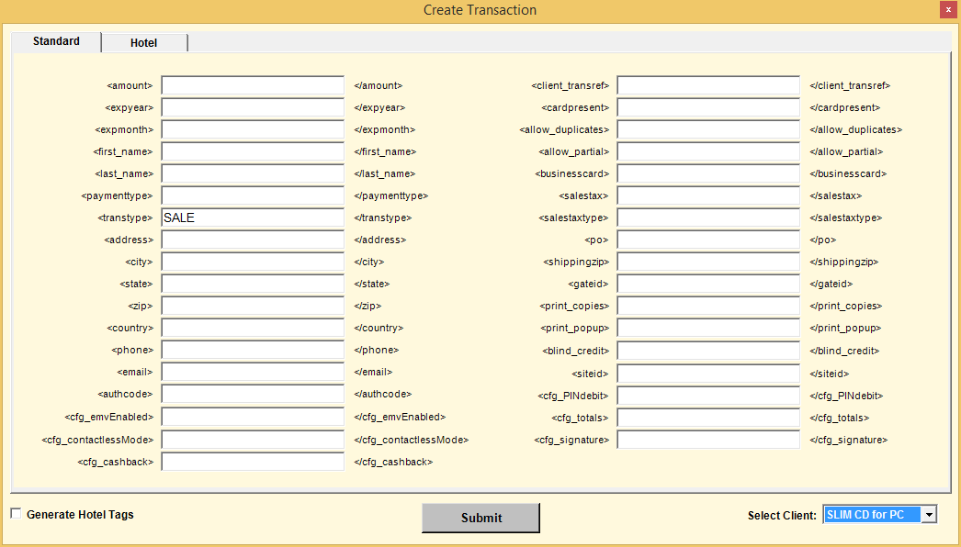
VB and.NET versions of “Launcher app
Supports
TransClient
SlimCDForPC

Slide 18
Mobile – EMV devices
Apple/IOS, Google/Android, Microsoft/WinPhone
Supports swiped and keyed today.
Support for IDTECH EMV Headset Jack in development
IDTECH’s new contact/contactless device coming
Support for IDTECH BTPay Pinpad (Bluetooth with PIN capability)
“Launch Our App” functionality still available.
Microsoft Win8/Win10 Tablets will be supported

Slide 19
Unified API
PC
Mobile
Web

Slide 20
Slim CD Libraries & Web Services
http://developer.slimcd.com
http://www.slimcd.com/developers/downloads
Using the Library:
ProcessTransactionRequest req ;
ProcessTransactionReply reply ;
Launching our App:
LaunchTransactionConfig cfg ;
LaunchTransactionRequest req ;
LaunchTransactionReply reply ;

Slide 21
SLIM CD for EMV – Hardware Abstraction
function int Hardware.Initialize (ConfigFile,callback)
function Hardware.GetCapabilities()
function Hardware.ProcessTransaction (config, request)
function Hardware.CloseConnection()

Slide 22
New .NET version of “Launcher app
Supports
TransClient
SlimCDForPC
Identifies the differences
New tab to create the XMLLOGON
(Available later today?)

Slide 23
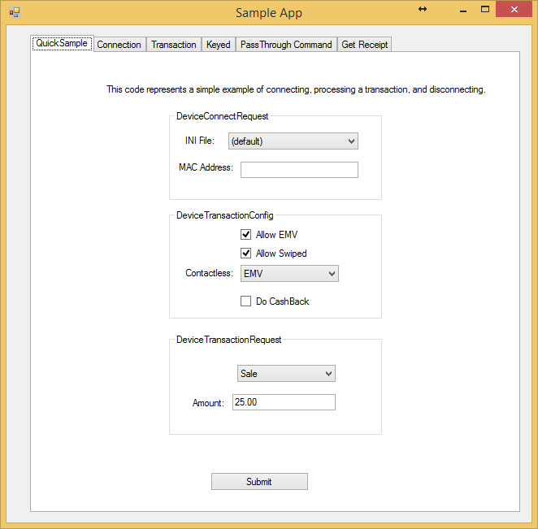
Demo Hardware Sample
Sample code for this tab
on the following page.

Slide 24
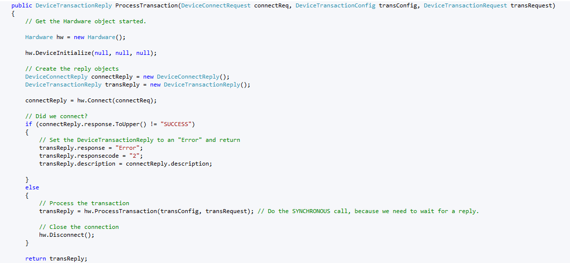

Slide 25
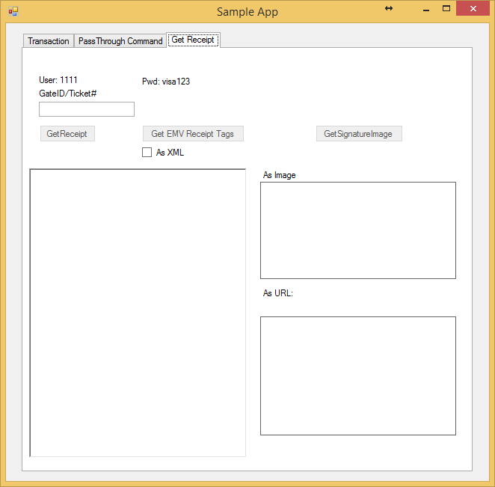
Receipt Information

Slide 26
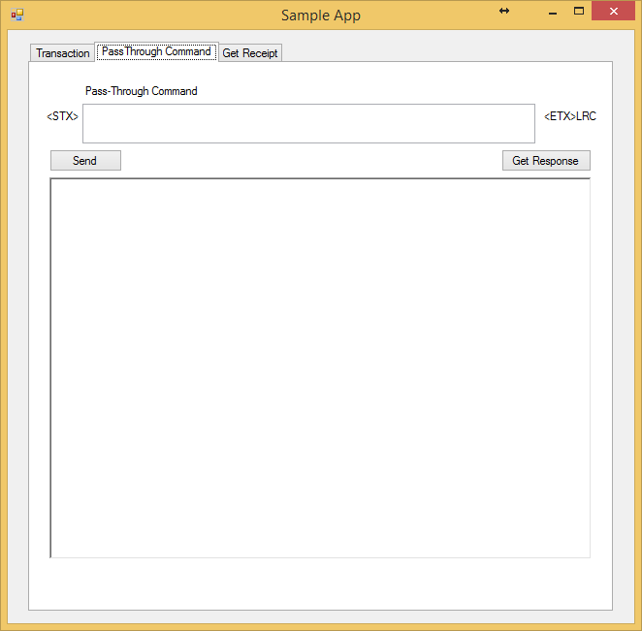
Pass Through Command

Slide 27
WebService
http:/testdevice.slimcd.com/devices.asmx
Accepts JSON in name/value pairs:
connect= { json for a DeviceConnectRequest }
cfg= { json for a DeviceTransactConfig }
req= { json for a DeviceTransactRequest }
Returns XML of the data (Will also return JSON soon)

Slide 28
WebService
Standard .NET webservice
Connects:
TCP/IP
MAC
UDP
Can Identify device by MAC or Serial#

Slide 29
DeviceTransactionReply from WebService

Slide 30
Suggested Tools from the manufacturers
You WILL want/need to play with these devices and get to know them!
VeriFone
Drivers for 32 and 64 bit
vFHostTerm allows command testing
MXDownloader – update OS, XPI, etc
DDL.EXE - Used for downloads
FormManager
Ingenico
RBA Drivers and kits
RBA Test Application
LLT.EXE - Used for downloads
Ingenico Telium Forms Tool

Slide 31
Slim CD Libraries & Web Services
New websites
http://developer.slimcd.com
http://www.slimcd.com/developers/downloads
EMV Developer’s Kit RESOURCES page
http://test.slimcd.com/EMV

Slide 32
EMV Configuration

Slide 33
Supporting Merchants
Ordering Hardware
Prices change with inventory levels
Always “get a quote”
The internet has better pricing, but for the wrong thing
Correct cabling
USB is not “USB” as we know it.
Some assembly required
Bring a small screwdriver for VX assembly
Additional parts (and more parts)
Power supplies
Ethernet/USB cables
I/O Blocks

Slide 34
Google Search for Pinpads or Cables
Lots of “knock offs”
Lots are contact-only
Prices are misleading
Most Internet deals require getting a merchant account from the seller.

Slide 35
VeriFone VX Cables to use
USB: CBL282-038-01-A
Last digit 01, 02, or 03
(1=1m long, 2=3m long, 3=1.8m long)
Ethernet: CBL-282-006-01
PWR-282-001-01
BLOCK with USB: CBL-282-044-01
PWR-282-001-01

Slide 36
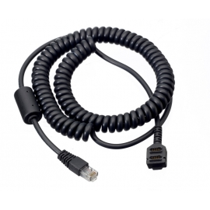
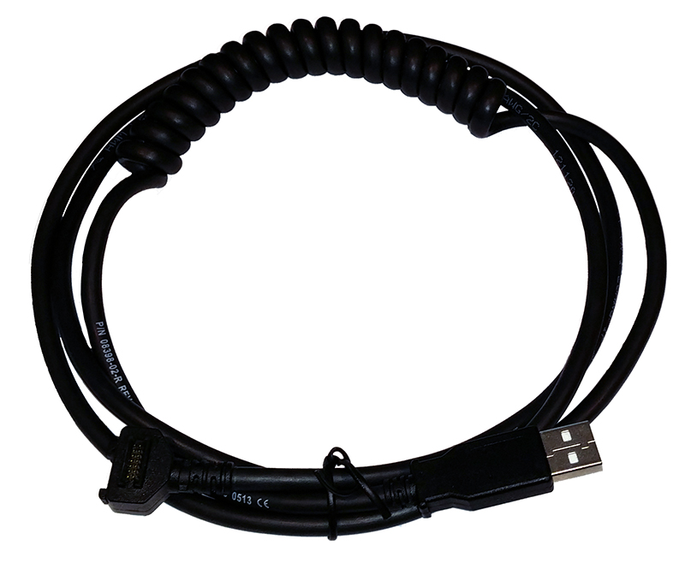
VeriFone VX Cables – Contact/Contactless
The “head” of the cable can have 1 set of pins or 2 sets of pins. You need BOTH sets to do CONTACTLESS.
CONTACT-ONLY
CONTACT AND CONTACTLESS

Slide 37
VeriFone MX Cables to use
VeriFone says the built-in ports will cause you grief.
I/O Module – You need one for the cables
P132-602-00-R (Red, with extra ports)
P132-601-00-R (No extra ports)
Cables are color-coded and fit into I/O module
USB Cable: 23741-02-R (BLUE)
TCP/IP CABLE: 24173-02 (PURPLE). This IS AN EXPENSIVE CABLE!
Power Supply: PWR132-003-01-A (FOR A CABLE!)

Slide 38
Ingenico Cables
Same cables for IPP or ISC devices
Same connection for USB, Serial or TCP/IP
Power supply needed on ALL cables

Slide 39
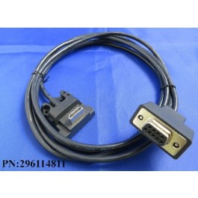
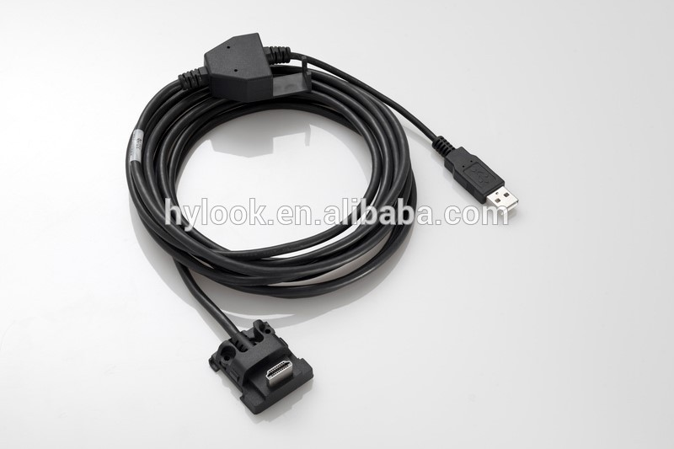
Ingenico connectors are the same

Slide 40
Code signing
Whoever downloads the first “signed” package into a VeriFone “owns” the device in VeriFone’s eyes. If you buy one one EBAY, you may NOT be able to configure and use it!
Code is signed by VeriFone. Slim CD has it’s own signing keys at VeriFone. VeriFone also uses their own DEV signing key.\
Removing an old signature requires either sending back to VeriFone or getting a special file from them per serial number. This will WIPE EVERYTHING, including PIN DEBIT keys.
Ingenico signs their products, but differently. It can be updated afterwards.

Slide 41
Remote Key Management
PIN DEBIT or MSR keys
Done by downloading a “signed package” from VeriFone or Ingenico.
This means THEY MUST HAVE the key.
They both have SLIM CD’s keys, but they MAY NOT have the PIN DEBIT keys for everyone.

Slide 42
CAPK
Certificate of Authority Public Keys
Issued by each “brand”
There are “test” and “production” values. You need the right one in the right situation.
Downloaded anytime, and MUST be maintained as the card brands update the keys.
Processors are starting to “deliver” keys when batches close
Merchants have 6 months from the expiration of a key to get it off the device.
https://www.eftlab.co.uk/index.php/site-map/knowledge-base/243-ca-public-keys

Slide 43
Estate Management
Tracking devices by serial number (we now send Device Serial Number and other data PER TRANSACTION)
Inventorying the software version of devices in the field. All must be kept in sync with gateway updates. NOT AN OPTION.
Updating CAPK keys
Pushing new patches as they are released
And certified? - Does the change require a recert?
PCI?
New firmware?
New Kernel? (DOES require recertification)

Slide 44
Estate Management Options
The device does NOT need to be connected to the internet. The software that manages the device does.
VeriFone and Ingenico offer these products
ISOs and processors may or may not include you in their offering (they DO have this for terminals already, they just are not eager to use it for PINPADS… Don’t know why, other than the effort to do it)
SLIM CD will have a solution that works with it’s systems and coordinates with it’s payment gateway releases.

Slide 45
EMV Devices - Costs in time and effort
Procuring proper devices
Assembling the hardware
Loading the firmware
Inventory management and tracking
Updating and maintenance
Configuring for merchant-specific desires (credit, debit, etc)
Understanding the data requested and the impact
Floor Limits
TAC values, Terminal Capabilities settings, VISATTQ, etc
https://www.eftlab.com.au/index.php/site-map/our-articles/161-the-use-of-ctqs-and-ttqs-in-nfc-transactions

Slide 46
Contact and Contactless
These are so similar, but are two different “worlds”.
Ingenico has separate XML configuration files for each
Data can fall back to CONTACT settings when doing contactless, but not the other way
There are different “limits” and constraints
There is a different “transaction flow” for contactless
Effects cabling, software configuration, and terminal options.

Slide 47
Processor Scheduling
We are working with 3 processors to start:
Vantiv - Have finished message testing. They made changes since we last ran, so they asked us to re-run some contactless tests (should be done next week)
TSYS has an issue with their own DEBIT keys and are issuing new test key. Once available, we will finish the last 6 messaging transactions with them
First Data North – Recoding for Restaurant & Hotel in progress so we can support EMV on NORTH (we previously only did Retail on North, because that’s all that needed PIN DEBIT before EMV changed everything)
Other processors will be done next year
Global
Elavon
Chase/Paymentech
RBS WorldPay

Slide 48
Estate Management & Configuration
Database Designed
Local Version
Microsoft Azure “Cloud” version
Internal Maintenance Tools
MS-Access
Web
Device-Specific Data
Verifone 75% complete
Ingenico ready for data entry
IDTECH (Mobile/BTPay) starting

Slide 49
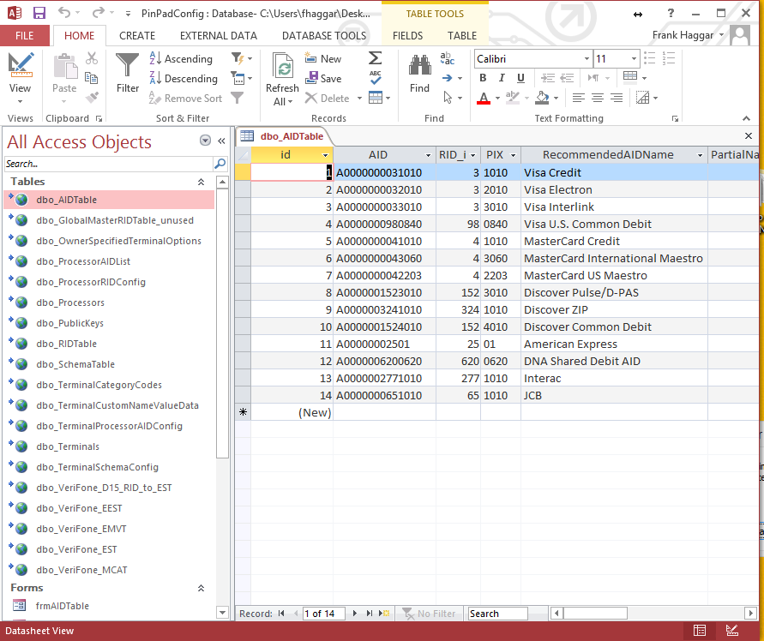
Internal tool for data entry
Hierarchical Data
Schema - Card Brand
RID Data – Card Plan
AID Data – Card Specifics
CAPK – Public Keys
Processor Data
Supported AIDs
Required DDOL
Floor & other limits
Terminal Data
Caps – Device Capabilities
TAC – Terminal Action Codes
Available features/prompts, etc
Merchant Data
Cards – Credit/Debit, etc
Floor Limts & options

Slide 50
PinPad Configuration

Slide 51
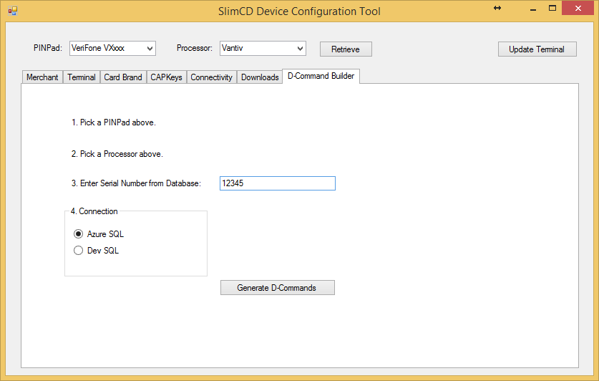
VeriFone: Generate D-Commands

Slide 52
Sample Output
<?xml version="1.0" encoding="UTF-8"?>
<SlimCDTerminalConfigForVerifone>
<Commands>
<LINE_0000 type="DCommand">4431323030</LINE_0000>
<LINE_0001 type="DCommand">4431363031303038</LINE_0001>
<LINE_0002 type="DCommand">44313500783000000000005649534100000000000000000000 … 00000</LINE_0002>
<LINE_0003 type="DCommand">44313500783000000000004D61737465724361726400000000 … 00000</LINE_0003>
....
<LINE_0278 type="DCommand">443137002F30303041303030303030363230303632300000000 … 303030</LINE_0278>
<0279 type="Reboot"></0279></Commands>
<Control>
<TerminalOwner>Vantiv Test Device</TerminalOwner>
<TerminalMake>VeriFone</TerminalMake>
<TerminalModel>VeriFone</TerminalModel>
<TestOrProduction></TestOrProduction><TerminalSerialNumber>12345</TerminalSerialNumber>
<ProcessorName>Vantiv</ProcessorName>
<CommandCount>280</CommandCount>
</Control>
</SlimCDTerminalConfigForVerifone>

Slide 53
Alternative Configurations
Each option requires a new certification (per device, per processor)
We can turn off a certified option WITHOUT having to re-certify
Some MCC codes require independent certification
Kiosk, unattended, and other configurations are considered separate certifications
Feel free to review EMV BOOK 4 and the VeriFone/Ingenico letters and let us know if you need a different certification.

Slide 54
EMV Considerations

Slide 55
EMV - EMV Kernels expire!

Slide 56
EMV Certifications Expire
Contact good for 3 years
Contactless good for 2 years
CONTACT CERT – 3 Years | CONTACT CERT – 3 Years
CONTACTLESS CERT 2 yrs | CONTACTLESS CERT 2 yrs | CONTACTLESS CERT 2 yrs

Slide 57
EMV Certifications - Timeline
Contact good for 3 years
Contactless good for 2 years
YEAR 1 | YEAR 2 | YEAR 3 | YEAR 4 | YEAR 5 | YEAR 6
CONTACT CERT | CONTACT CERT
CONTACTLESS CERT | CONTACTLESS CERT | CONTACTLESS CERT
 |  | cless resert | cont resert | cless resert
There is a 2 year use from the certifications.
THEN recertify for each of the next 3 years
Then skip a year and start again.

Slide 58
SLIM CD Responsibilities
SlimCD is your Payment Gateway and PC Software Provider.
Avoid EMV Certifications
Reduce PCI Risks
Provide an Omni-Channel suite of software products that touch cardholder data and accept transactions
We provide assistance with the payment within our software
Most merchant services providers and POS vendors wish to use their existing hardware vendors and keep costs for customers to a minimum. We agree. Use your preferred vendors to install the hardware and associated drivers, etc.

Slide 59
Hardware Ordering Details
Hardware Distributors install the default values for a device, based on the order
Operating System
Applications
PIN Keys
Data/MSR Encryption keys (P2P)
Devices will need to be injected with PIN Debit keys by an authorized injection facility (wherever you do it today). The merchant account provider’s keys will need to be used. Contact that provider to identify which facility injects keys on their behalf.
Distributors can request “bundles” that contain a standard SLIM CD configuration for VeriFone software so that it can be used out of the box. Ingenico can already be used out of the box and needs no such bundle
VeriFone MX devices – Use XPI 5200P, signed by SLIM CD
VeriFone VX devices – Use XPI 8.4.3, signed by SLIM CD
Ingenico devices – Use RBA 16.02

Slide 60
Connectivity Options
USB/Serial – Available today
USB/HID – An Ingenico option, available today
TCP/IP – Available on Ingenico, coming soon to VeriFone
VeriFone considerations
Static IP –vs- DHCP
Find device by MAC
SSL on or off
Proxy Server
PassPhrase / Client Auth / Server (See vHostTerm for these options)

Slide 61
Customer “Look & Feel”
Once we certify an OS with an XPI or RBA, it MUST remain that way
Custom forms can be used without needing certification
VeriFone
FormAgent forms can be downloaded outside of XPI and can be done at any time
XPI Packages WILL need to be signed (offline discussion for those that want to provide custom logo or branding for their customers)
Ingenico
Custom forms can be downloaded outside of RBA updates without being signed.

Slide 62
Additional Opportunities
We recommend that the hardware reseller deliver the hardware and install the drivers on the PC, configure the hardware (if needed) then test it for proper operation.
Some maintenance will need to be performed to the devices as the CAPK keys are expired/retired in 2017.
For those that wish to be “hands off” and have carte-blanche services, SLIM CD can assume the responsibilities for PC driver installation, hardware configuration, ongoing device maintenance etc. Stay tuned for more information on this option, including a schedule of fees and referral income options for this service.

Slide 63
Q & A
Getting help from VeriFone and Ingenico is difficult at this time.
Questions on EMV… Send emails to: frank@slimcd.com

